Slide 1

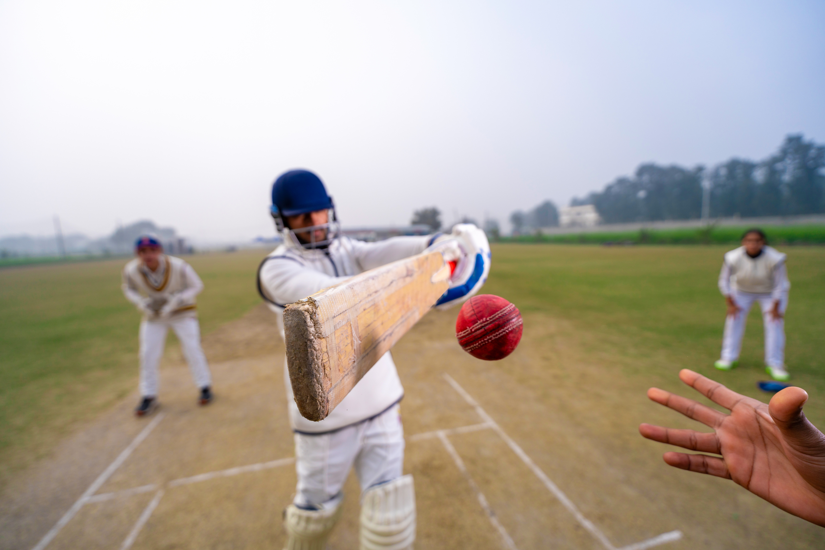




Indian Premier League
By
Vasandharaja S

Slide 2

Introduction:
The Indian Premier League (IPL) revolutionized the world of cricket since its inception in 2008.
With a unique combination of high-stakes T20 cricket, entertainment, and commercial appeal, the IPL has grown into one of the biggest sporting events globally.
Analyzing the IPL from 2008 to 2017 gives us valuable insights into the development of the league, the evolution of team strategies, and the performance trends of both players and franchises over the first decade.

Slide 3
Teams of IPL:
Delhi Daredevils
Kings XI Punjab
Kolkata Knight Riders
Mumbai Indians
Chennai Super Kings
Royal Challengers Bangalore
Rajasthan Royals
Sunrisers Hyderabad

Slide 4
Defunct Teams :
Deccan Chargers (DC)
Kochi Tuskers Kerala (KTK)
Chennai Super Kings (CSK)
Rajasthan Royals(RR)

Slide 5
Tournament Results:
Year | Winner | Runner-up | Final Result
2008 | Rajasthan Royals | Chennai Super Kings | Rajasthan Royals won by 3 wickets
2009 | Deccan Chargers | Royal Challengers Bangalore | Deccan Chargers won by 6 runs
2010 | Chennai Super Kings | Mumbai Indians | Chennai Super Kings won by 22 runs
2011 | Chennai Super Kings | Royal Challengers Bangalore | Chennai Super Kings won by 58 runs
2012 | Kolkata Knight Riders | Chennai Super Kings | Kolkata Knight Riders won by 5 wickets
2013 | Mumbai Indians | Chennai Super Kings | Mumbai Indians won by 23 runs
2014 | Kolkata Knight Riders | Kings XI Punjab | Kolkata Knight Riders won by 3 wickets
2015 | Mumbai Indians | Chennai Super Kings | Mumbai Indians won by 41 runs
2016 | Sunrisers Hyderabad | Royal Challengers Bangalore | Sunrisers Hyderabad won by 8 runs
2017 | Mumbai Indians | Rising Pune Supergiants | Mumbai Indians won by 1 run

Slide 6
Rules and Regulations:
Format of the Tournament
Player Regulations
Match Rules
Code of Conduct
Match Fixing and Corruption
Suspension and Termination of Teams
Umpires and Decision Making
Financial Rules
Strategic Timeout

Slide 7
Conclusion :
The 2008-2017 IPL years can be described as a period of growth, challenges, and triumphs. The league successfully established itself as a world-class sporting event, delivering thrilling cricket, generating massive revenue, and bringing together fans from across the globe. While there were occasional setbacks and controversies, the IPL's ability to recover and grow in stature was evident, with its focus on quality cricket, entertainment, and commercialization.
In summary, the IPL from 2008 to 2017 not only revolutionized the cricketing landscape but also created an unparalleled fusion of sports, entertainment, and business. As it continued to evolve, the tournament laid a solid foundation for future generations of cricketers and fans, ensuring its place as one of the most exciting leagues in the world.

Slide 8
Thankyou.....

